Slide 1
ONAP Portal
OSS/BSS
…
SDC
SO
API Handler
Request Handlers
AAI
Service Recipes
BPMN Execution Engine
Data Stores
Service Recipe
Catalog DB
Request DB
Service Recipe
HEAT Templates
HELM
REST
AAI Util
OOF
Adapters
NSSMF Adapter
SOL005 Adapter
SOL003 Adapter
OOF Adapter
VNFM Adapter
Ve-VNFM Adapter
CNF Adapter
Openstack Adapter
ETSI NFVO
VNFM Adapter
VE-VNFM Adapter
KEYSTONE/ HEAT / REST
SDNC
K8s-plugins
Multi Cloud
(Open stack)
VFC
External VNFM
APPC

Slide 2
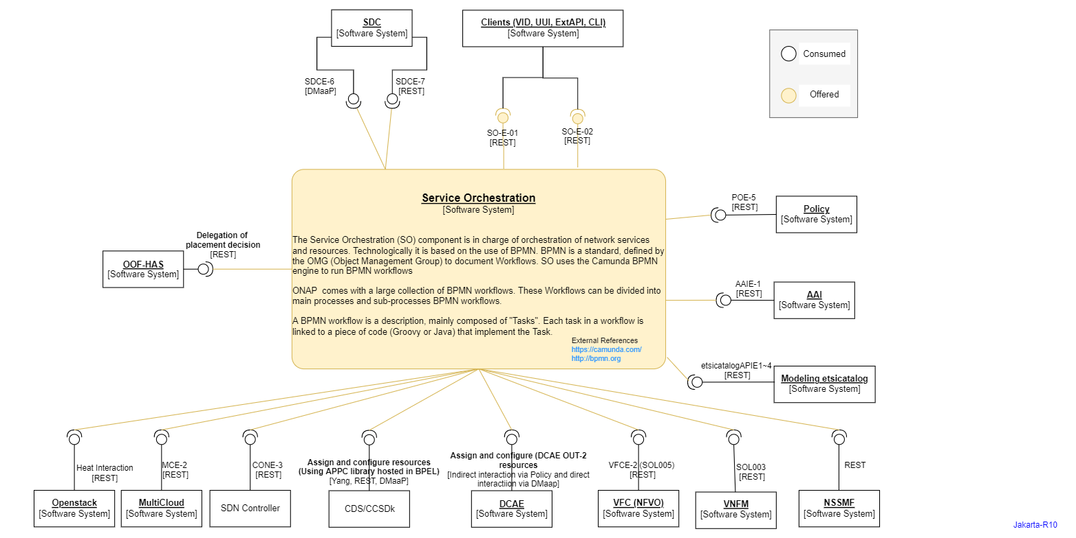

Slide 3
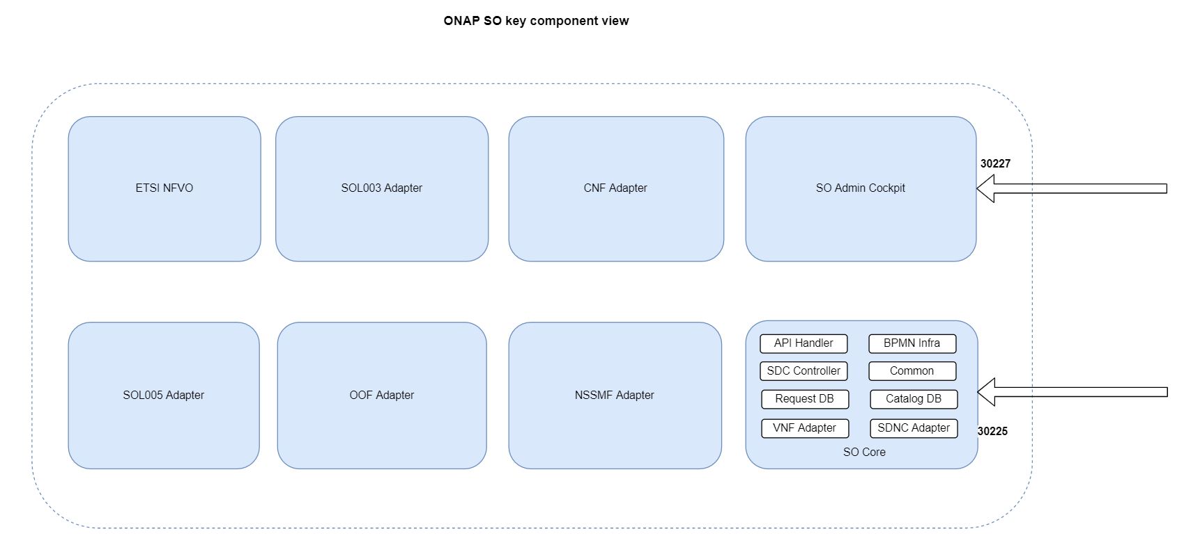

Slide 4
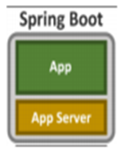
Deployment View
Spring Boot Application
BPMN Infra Jar
Request DB Adapter Jar
SDNC Adapter Jar
Cloud Adapter Jar
API Handler Jar
SDC Controller Jar
Catalog Adapter Jar
VFC Adapter Jar
VNFM Adapter Jar

Slide 5
Ext API
VID
UUI
CLI
DCAE
AAI
SDC
SO
OOF
Policy
VFC
MultiVim
APPC
SDNC

